Slide 1
Smart Wearables and Wireless Body Sensor Networks for Health Monitoring Applications ODELOLA SOLOMON OLUWATOBILOBA

Slide 2
Introduction
Stress is a significant threat to human health.
50% of work-related diseases are due to stress (HSE, 2022).
Chronic stress linked to heart disease, diabetes, and obesity.
Traditional stress assessment: Perceived Stress Scale (PSS).
Wearable devices offer real-time stress monitoring.
AI and wearables can predict stress episodes.
Concerns about data privacy with wearables.

Slide 3
Research Aims and Objectives
Aim: To assess the effectiveness and applicability of predictive models for stress prediction using both real-world SWELL dataset and synthetic numerical simulation data.
Objective
Develop models using SWELL dataset.
Develop models using synthetic data.
Objective 3: Compare performance of models.
Objective 4: Identify strengths and weaknesses.
Objective 5: Assess model generalization.
Objective 6: Understand practical applications.
Objective 7: Understand effectiveness in real-world scenarios.

Slide 4
Overview
Key studies have highlighted the increasing prevalence of stress in modern society and the potential of wearable technology in monitoring and predicting stress.
Research has shown a strong correlation between physiological signals (like heart rate variability) and stress levels.
The integration of machine learning with wearable tech has opened new avenues for real-time stress prediction, offering potential benefits for mental health interventions.

Slide 5
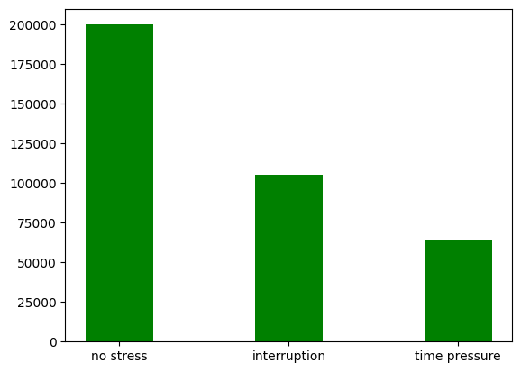
EXPLORATORY DATA ANALYSIS
The bar chart or histogram represents the distribution of stress levels amongst the subjects, as measured by the wearable devices used in our study. The y-axis represents the count of instances, and the x-axis represents the three types of stress conditions

Slide 6
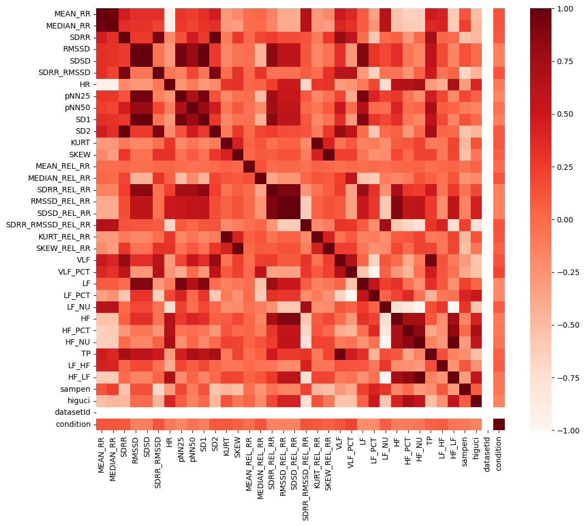
Correlation of all columns in the dataset
These correlation values, spanning from -1 to 1, offer a preliminary understanding of the possible relationships between these variables and the 'condition', potentially indicating the predictors for stress conditions.

Slide 7
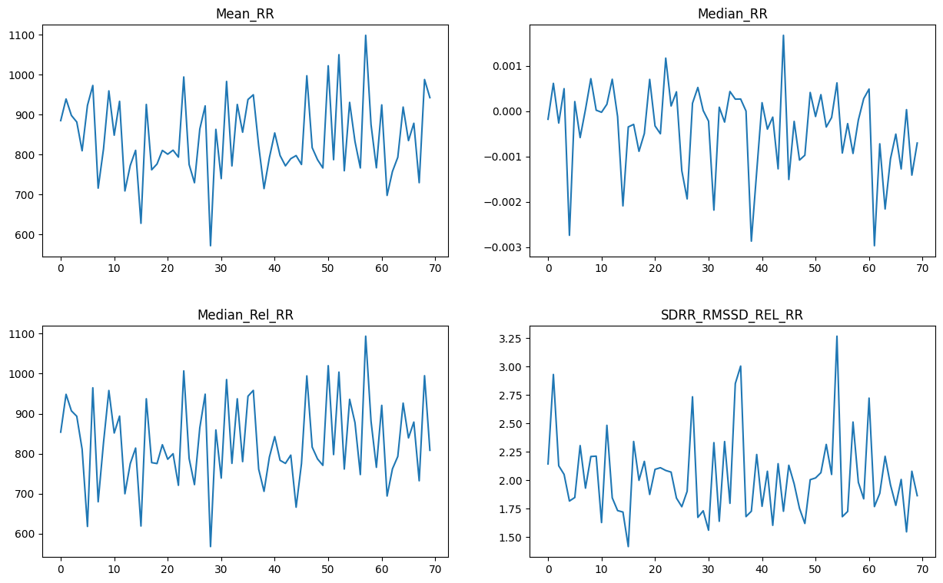
Plotting some of the extracted features
we plotted the line graphs of four different variables, namely 'MEAN_RR', 'MEDIAN_RR', 'MEDIAN_REL_RR', and 'SDRR_RMSSD_REL_RR'. These variables were selected based on a predefined correlation threshold of 0.1 with the 'condition' variable

Slide 8
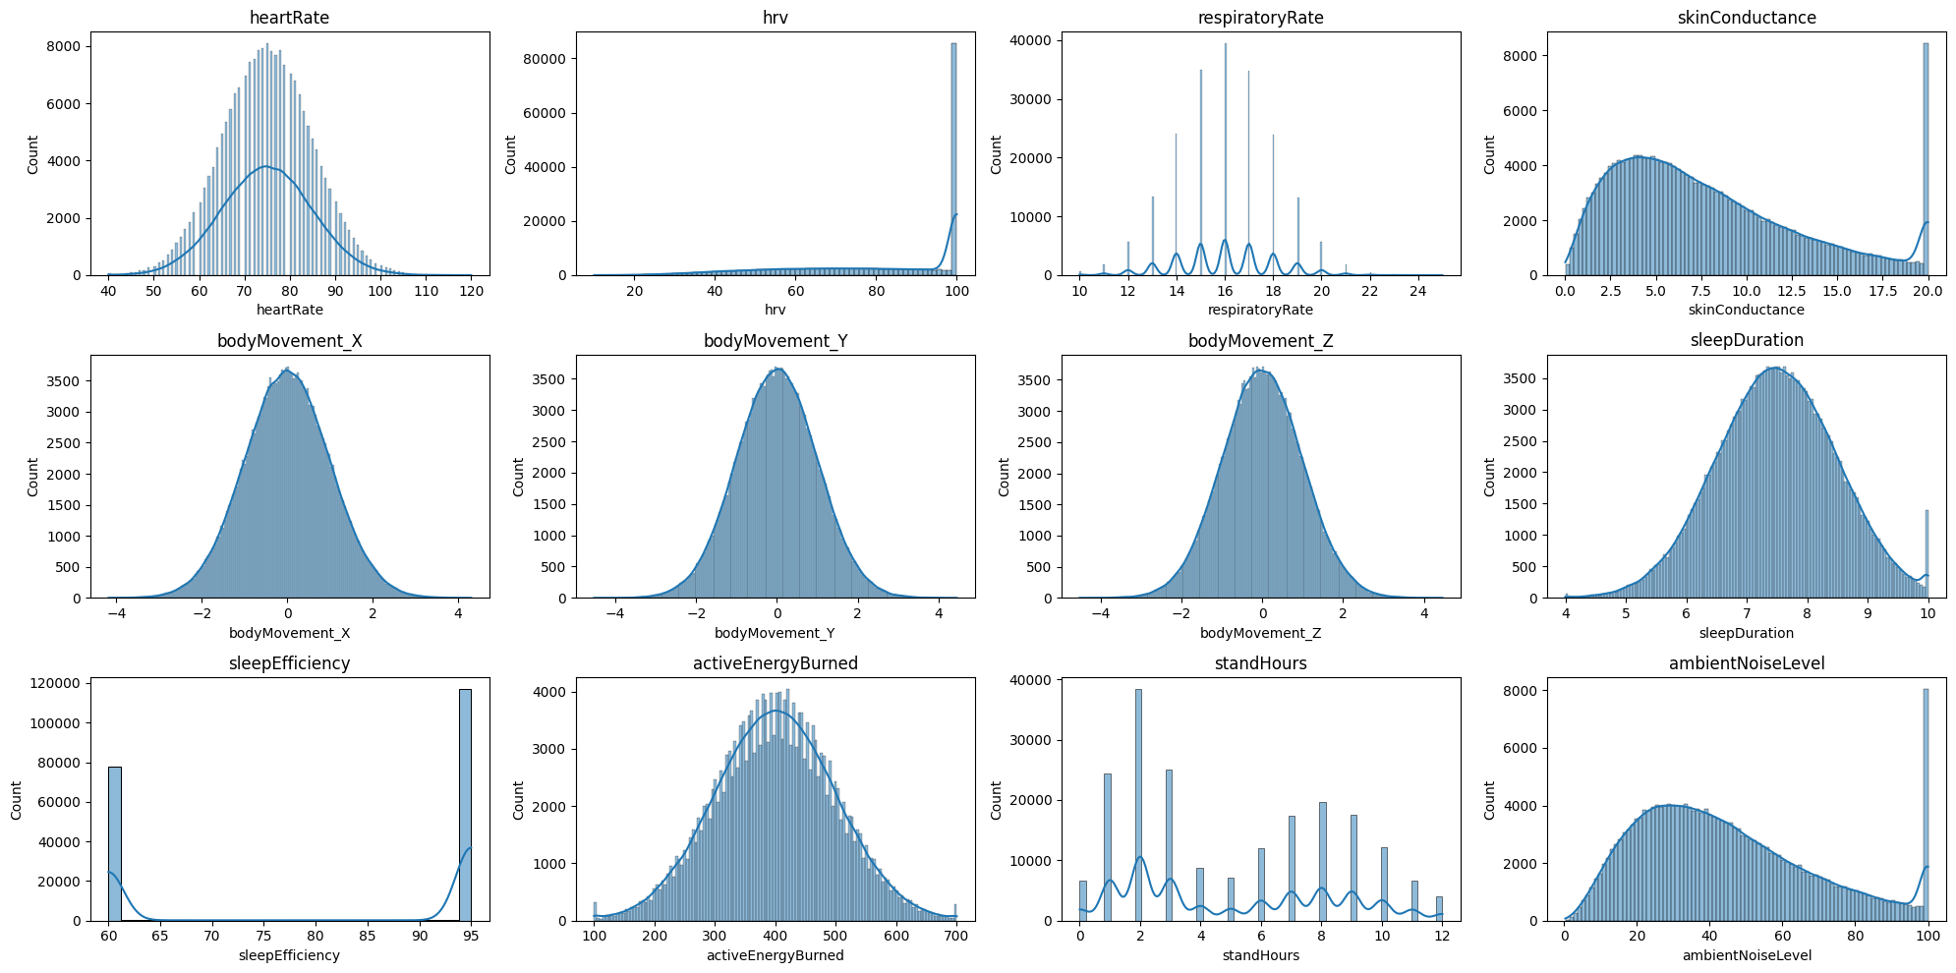
Exploratory Data Analysis: Wearable Device Simulated Data

Slide 9
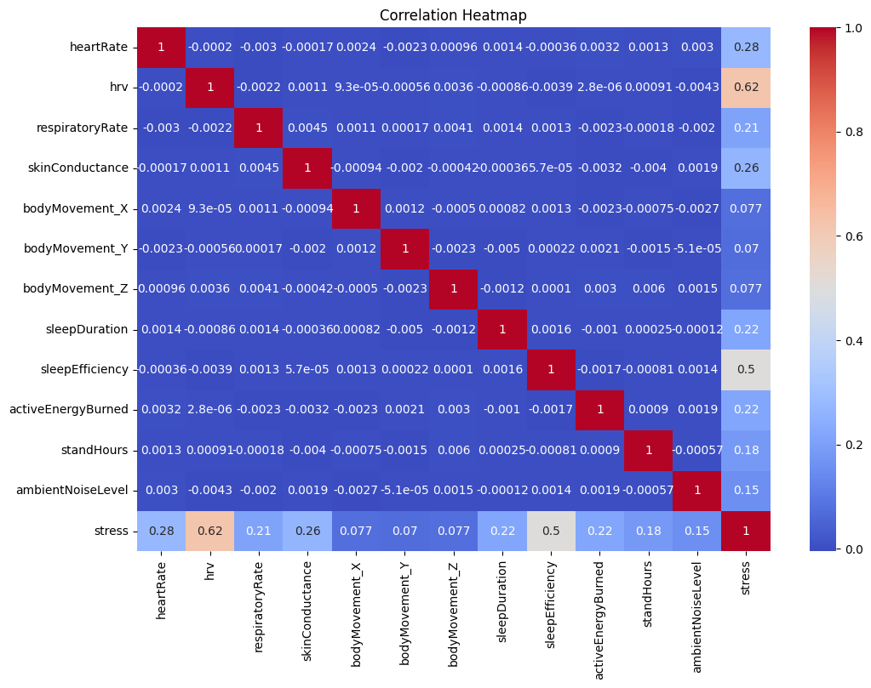
Heatmap of the generated data

Slide 10
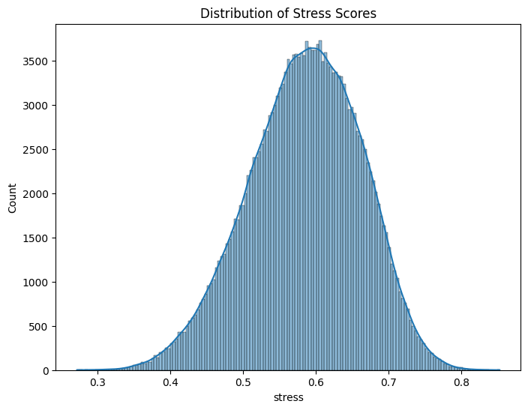
Distribution of Stress scores
The majority of stress scores cluster within the range of 0.5 to 0.7, indicating a prevalent level of moderate stress among the subjects. The stress scores' concentration in this range suggests that the participants experienced a consistent and relatively moderate level of stress.

Slide 11
Key Findings
The SWELL-KW dataset, a prominent resource in stress prediction research, has been extensively used due to its comprehensive nature.
Studies have shown the effectiveness of ensemble learning methods in improving prediction accuracy.
Recent advancements, such as the CatBoost algorithm, have further enhanced the predictive capabilities of machine learning models.
Despite the progress, challenges remain in terms of data privacy, real-time processing, and ensuring model robustness across diverse populations.

Slide 12
Methodology: Data Utilization
Data is the backbone of this research. It's divided into three main categories:
SWELL-KW Dataset: A rich dataset for stress prediction, capturing heart rate variability and other metrics.
Wearable Device Simulated Data: Simulated data emulating recordings from an Apple Watch, including heart rate, respiratory rate, and more.
Stress Score Calculation: A multi-step process that assigns weights to features, normalizes data, and calculates a quantifiable stress score.

Slide 13
Methodology: Machine Learning Algorithms
Five algorithms were chosen for their unique mathematical foundations and practical benefits to be combined in an ensemble form
Naive Bayes: A probabilistic classifier based on Bayes' theorem.
Logistic Regression: A statistical method for binary classification.
Support Vector Machines (SVM): Classifies data by finding the optimal hyperplane.
CatBoost: A gradient boosting algorithm that handles categorical variables.
Multilayer Perceptron (MLP): A type of artificial neural network.
Ensemble methods combine multiple models to improve accuracy and robustness.
Bagging (Bootstrap Aggregating): Enhances model diversity by manipulating the stochastic distribution of training datasets.
Stacking: Uses a meta-model to integrate and learn from the predictions of base models, capturing more complex patterns in the data.

Slide 14
Methodology: Performance Metrics
Metrics are essential for evaluating model effectiveness:
Accuracy: Measures the ratio of correctly predicted observations to total observations.
Precision: Assesses the proportion of correctly identified positive observations from predicted positives.
Recall: Measures the proportion of correctly identified positive observations from actual positives.
AUC-ROC: Represents the model's performance across all thresholds.

Slide 15
Results: SWELL-KW Dataset
Algorithm | F1 Score | Precision | Recall | Average AUC
CatBoost | 0.991800 | 0.991800 | 0.991800 | 0.999546
Naive Bayes | 0.905575 | 0.905575 | 0.905575 | 0.989132
Logistic Regression | 0.999100 | 0.999100 | 0.999100 | 0.999963
RFC | 0.947600 | 0.947600 | 0.947600 | 0.980529
MLP | 0.997325 | 0.997325 | 0.997325 | 0.999851

Slide 16
Results: SWELL-KW Datset
Key performance metrics: F1 Score, Precision, Recall, Average AUC.
Top performers: CatBoost and RFC with near-perfect scores.
Potential overfitting concerns with perfect scores.
Naive Bayes and Logistic Regression: Lower performance but notable Average AUC.
MLP: Strong performance, nearly on par with CatBoost and RFC.

Slide 17
Results: SWELL-KW Dataset
 | Bagging Ensemble | Stacking Ensemble
F1 Score | 0.9995125874296298 | 1.0
Precision | 0.9995125874296298 | 1.0
Recall | 0.9995125874296298 | 1.0
Ensemble methods: Enhanced predictive performance, potential overfitting concerns.
The significance of the Stacking Ensemble's results lies in its potential application. If the model genuinely holds its ground in real-world scenarios, it could revolutionize stress management.
Imagine wearable devices that can predict, with unfaltering accuracy, when a user is on the brink of a stress-induced breakdown, allowing for preemptive measures.

Slide 18
Results: Wearables Device Simulated Dataset
Algorithm | F1 Score | Precision | Recall | Average AUC
CatBoost | 0.991800 | 0.991800 | 0.991800 | 0.999546
Naive Bayes | 0.905575 | 0.905575 | 0.905575 | 0.989132
Logistic Regression | 0.999100 | 0.999100 | 0.999100 | 0.999963
RFC | 0.947600 | 0.947600 | 0.947600 | 0.980529
MLP | 0.997325 | 0.997325 | 0.997325 | 0.999851

Slide 19
Results: Wearables Device Simulated Dataset
Key performance metrics: F1 Score, Precision, Recall, Average AUC.
Logistic Regression: Best overall performance.
CatBoost: High performance, especially in Average AUC.
MLP: Strong potential, RFC: Moderate scores, Naive Bayes: Decent Average AUC.

Slide 20
Results: SWELL-KW Dataset
 | Bagging Ensemble | Stacking Ensemble
F1 Score | 0.930425 | 0.999275
Precision | 0.930425 | 0.999275
Recall | 0.930425 | 0.999275
These figures suggest that the Bagging Ensemble method is an effective model for stress prediction using wearable device data.
The F1 Score, which represents a balance between precision and recall, is quite high. It indicates a reasonable harmony between the proportion of true positive predictions and the ability to correctly identify positive cases.
These near-perfect scores imply that the Stacking Ensemble method is exceptionally reliable for stress prediction using the given dataset. The F1 Score, which is almost perfect, represents a strong harmony between precision and recall. .

Slide 21
Comparing Datasets & Preferred Approaches
Comparison between SWELL-KW Dataset (real-world) and Wearable Device Simulated Dataset reveals consistent strengths of certain algorithms/methods.
CatBoost & Logistic Regression: Consistent top performers across datasets. CatBoost excels with categorical features, while Logistic Regression is highly generalizable.
Ensemble Methods (especially Stacking): Produced remarkable results, indicating the power of combining models for enhanced predictive accuracy.
Caution: Perfect scores in some methods hint at potential overfitting risks.
Preferred Approach: Depends on application's context/goals. For robustness & reliability - CatBoost, Logistic Regression, or MLP. For utmost accuracy - Stacking Ensemble, with overfitting awareness.
Key Takeaway: Evaluating algorithms in diverse scenarios is vital for ensuring adaptability & reliability across different contexts.

Slide 22
Conclusion
The study delves into stress prediction using wearable devices and wireless body sensor networks.
Results from both datasets reveal the strengths and limitations of various machine learning algorithms and ensemble methods in different scenarios.
Central hypothesis: Ensemble learning methods can enhance the accuracy and reliability of stress prediction.
Ensemble methods, especially Bagging and Stacking, have shown potential in improving predictive accuracy by leveraging multiple models.
Bagging Ensemble method: Demonstrated reliability in producing accurate predictions.
Stacking Ensemble method: Achieved near-perfect scores but raised concerns about overfitting.

Slide 23
Project Link:

